Slide 2
References
CS229 Lecture notes - Andrew Ng
Machine Learning Nanodegree on Udacity

Slide 3
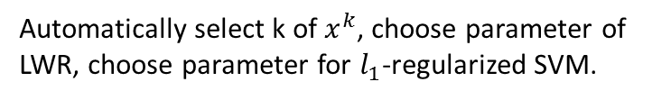
Principle
Approach: Careful Design vs Build-and-Fix
Step1 of designing a learning system: Plot the data.
X: features, y: targets
Data Types
Batch learning
Online learning
How do we pick, or learn, the parameters θ?
Cross Validation to help split
Testing Set
Training Set
Make predictions continuously while learning.
Measures, for each value of the θ’s, how close the h(x)’s are to the corresponding y’s.
Cost Function
Spot-checking algorithm
To choose θ so as minimize J(θ).
?
Learning Algorithm
Optimization Algorithm
LMS update rule
(Widrow-Hoff learning rule)
Gradient Descent
- Batch
- Stochastic (Incremental)
Newton’s Method(The Normal Equations)
Coordinate Ascent
Evaluation
Improve the results
Model Selection
Automatically select k of $x^{k}$, choose parameter of LWR, choose parameter for $l_{1}$-regularized SVM.
x
h (Hypothesis)
Predicted y

Slide 4
Principle - Python
Data Exploration (Feature Observation)
Split the data into inputs and output
Calculate descriptive statistics
Preprocess the data
* Transforming skewed continuous features: logarithmic transformation
* Normalizing numerical features
* Converting categorical variables: one hot coding
Split the data into training and testing sets

Slide 5
Principle - Python
Supervised Learning Models, currently available in scikit-learn
Gaussian Naïve Bayes (GaussianNB)
Decision Trees
Ensemble Method (Bagging, AdaBoost, Random Forest, Gradient Boosting)
K-Nearest Neighbors
Stochastic Gradient Descent Classifier (SGDC)
Support Vector Machine (SVM)
Logistic Regression

Slide 6
MLND Project_0: Titanic Survival Exploration
Decision Tree, a manual implementation of a simple machine learning model.
Data Exploration (Feature Observation)
Split the date into inputs and outputs
Predict
Score
A decision tree splits a set of data into smaller and smaller groups (called nodes), by one feature at a time. Each time a subset of the data is split, our predictions become more accurate if each of the resulting subgroups are more homogeneous (contain similar labels) than before.
Data Exploration
- 簡單統計分析資料找insight，加深條件

Slide 7
MLND Project_1: Predicting Boston Housing Prices
Data Exploration (Feature Observation)
Split the date into inputs and outputs
Calculate descriptive statistics
Split the data into training and testing sets
Developing a Model
Define a performance metric: r-square
Analyzing Model Performance
Learning Curves (X axis: Number of training point)
Complexity Curves (X axis: Model’s Complexity)
Analyze Bias / Variance Problem
Evaluating Model Performance
Cross Validation
Grid search

Slide 8
MLND Project_2: Finding Donors for CharityML
Data Exploration (Feature Observation)
Split the date into inputs and outputs
Calculate descriptive statistics
Preprocess the data
* Transforming skewed continuous features: logarithmic transformation
* Normalizing numerical features
* Converting categorical variables: one hot coding
Split the data into training and testing sets
Evaluating Model Performance
Define a performance metric: Accuracy, Precision, Recall, F-score
Apply multiple learning algorithm + naive predictor (benchmark)
Improving Results
Choosing the best model
Tuning the model
Feature Selection
Extracting feature importance
Feature Selection

Slide 9
MLND Project_3: Creating Customer Segments
PCA + Cluster
Data Exploration (Feature Observation)
Split the date into inputs and outputs
Calculate descriptive statistics: describe()
Preprocess the data
* Transforming skewed continuous features (Feature Scaling):
logarithmic transformation (Box-Cox test)
* Outlier Detecting (1.5*IQR)
Split the data into training and testing sets
Feature Relevance
Feature Transformation
PCA, Dimensionality Reduction
Evaluating Model Performance
Define a performance metric: Silhouette Coefficient
Apply k-means/Gaussian mixture model cluster
Data Recovery

Slide 10
MLND Project_4: Train a Smartcab to Drive
Reinforcement Learning, constructing an optimized Q-Learning
Build Evaluation Metrics: Safety and Reliability
Understand the world (environment) and the characteristics about the agent.
Step1. Implement a basic driving agent: Get the agent to actually take valid actions.
Step2. Inform the driving agent.
Define a set of state that the agent can occupy in the environment.
Define a state space that the agent could learn a policy for each possible state within a reasonable number of training trials.
Step3. Begin implementing the functionality of Q-Learning itself.
The concept of Q-Learning: For every state the agent visits, create an entry in the Q-table for all state-action pairs available. Then, when the agent encounters a state and performs an action, update the Q-value associated with that state-action pair based on the reward received and the interactive update rule implemented. Additional benefits come from Q-Learning, such that we can have the agent choose the best action for each state based on the Q-values of each state-action pair possible.
Decaying ϵ (exploration) factor: as the number of trials increases, ϵ should decrease towards 0. This is because the agent is expected to learn from its behavior and begin acting on its learned behavior. Additionally, The agent will be tested on what it has learned after ϵ has passed a certain threshold.
Step4. Perform the optimization.
One thing to keep in mind is the act of learning itself and the time that this takes: In theory, we could allow the agent to learn for an incredibly long amount of time; however, another goal of Q-Learning is to transition from experimenting with unlearned behavior to acting on learned behavior.
When improving on your Q-Learning implementation, consider the implications it creates and whether it is logistically sensible to make a particular adjustment.

Slide 11
MLND Project_5: Classify Images Using a Neural Network
Deep Learning, train a convolutional neural network
Data Exploration (Feature Observation)
Preprocess the data
* Normalizing images: np.array ((list od image data) / (image max value))
* One-hot encoding labels: np.eye(number of possible value of labels)[list of sample labels]
* Randomizing data
Build The Network
Input: image data, one-hot encoded labels, and dropout keep probability.
Convolution and Max Pooling layer
Flatten layer: change the dimension of x_tensor from a 4-D tensor to a 2-D tensor.
Fully-Connected layer
Output layer
Create Convolution Model
Train The Neuron Network
Single Optimization. -> Show Stats. -> Hyperparameters (Tune the following parameters: epochs, batch_size, keep_prob) -> Try to train on a single batch -> train on multiple batches.
Test Model

Slide 12
MLND Project_6: Capstone Project
Reinforcement Learning, constructing an optimized Q-Learning

Slide 13
Data Exploration

Slide 14
Data
Data Types
Why use training and testing data
Numeric data
- discrete
- continuous
Categorical data
- can take on numerical value (no meaning)
- ordinal data (order/ranking) (e.g. ‘low’, ’normal’, ’high’)
Time-series data
Text
Gives estimate of performance on an independent dataset.
Serves as check on overfitting.
-> Cross validation to help split.

Slide 15
Split The Data Into Training Set and Testing Set

Slide 16
Cross Validation – Hold-out (simple)
Python
Purpose
To avoid overfitting, hold out part of the available data as a test set X_test, y_test.
from sklearn.cross_validation (sklearn.model_selection) import train_test_split
X_train, X_test, y_train, y_test = train_test_split (features, labels, test_size = 0.4, random_state = 0)
Parameters
test_size: 0.4 means holding out 40% of the data for testing.
random_state:
K-fold
Run k separate learning experiments.
Pick testing set.
Train.
Test on testing set.
Average test results from those k experiments.
Pick a model class (different polynomial) has the lowest error.

Slide 17
Cross Validation – K-Fold
Python
Purpose
To avoid overfitting, hold out part of the available data as a test set X_test, y_test.
K-fold
Run k separate learning experiments.
Pick testing set.
Train.
Test on testing set.
Average test results from those k experiments.
Pick a model class (different polynomial) has the lowest error.
K=10
For testing
from sklearn.cross_validation (sklearn.model_selection) import KFold
kf = KFold (n_splits=2) #2-fold cross-validation

Slide 18
Regularization and Model Selection
Hold-out cross validation (simple cross validation)
K-fold cross validation
Leave-one-out cross validation
Cross Validation
Model Selection
Forward search + cross validation (Wrapper model feature selection)
repeatedly make calls to the learning algorithm
Feature Selection
Backward search + cross validation
repeatedly deletes features one at the time
Hold-out (=simple)
K-fold
Leave-one-out
Cross Validation
Filter feature selection + cross validation
common to choose S(i)to be the mutual information
-> Kullback Leibler (KL) divergence
Feature Selection
Wrapper feature selection (forward search)
Filter feature selection (backward search)
Embedded feature selection
Previous: Fit parameter using ML
frequentist view, theta as being not random, constant-valued, unknown
Battle against overfitting
Prior distribution -> posterior distribution
Bayesian view, theta as being random, unknown
Bayesian statistics and regularization
Difficult to compute -> approximate
MAP (Maximum a posteriori)

Slide 19
Feature Transformation

Slide 20
Feature Transformation
<Normalized> Always like our variables to be $E\left(x_{i}\right)=0$, $σ\left(x_{i}\right)=σ(x_{j})$
Easier to optimize

Slide 21
Preprocessing
Python
Normalize numerical data
Purpose
Normalize samples individually to unit norm.
from sklearn.preprocessing import Normalizer
normalizer = Normalizer().fit(features)
normalized_features = normalizer.transform(features)
Polynomial Features
Generate polynomial and interaction features. Generate a new feature matrix consisting of all polynomial combinations of the features with degree less than or equal to the specified degree. For example, if an input sample is two dimensional and of the form [a, b], the degree-2 polynomial features are [1, a, b, a^2, ab, b^2].
from sklearn.preprocessing import PolynomialFeatures
poly = PolynomialFeatures(degree)
polied_features = poly.fot_transform(features)

Slide 22
Feature Selection The objective of feature selection when training a model is to choose the most relevant variables while keeping the model as simple as possible, thus reducing training time.

Slide 23
Principal Component Analysis, PCA
Unsupervised
Classification
四大機器學習降維算法 (PCA(線性降維方法), LDA, LLE, Laplacian Eigenmaps)
Purpose
Reduce the number of features.
Dimensionality reduction: 以映射方法，將原高維空間中的資料(包含多餘/噪音信息而降低準確率)映射到低維度的空間中。
Discover which dimensions about the data best maximize the variance of features involved.
Report the explained variance ratio of each dimension- how much variance within the data is explained by that dimension alone.
Introduction
When to use PCA
Latent features driving the pattern in data. (e.g. big shot @ Enron)
Dimensionality reduction
* visualize high-dimensional data
* reduce noise
* make other algorithms (regression, classification) work better
because fewer inputs. (e.g. eigenfaces)
Principal component of a dataset is the direction that has the LARGEST VARIANCE because retains maximum amount of “information” in original data (minimizes information loss).
Project on it
o
Selecting a number of principal components
To figure out how many PCs to use -> train on different number of PCs, and see how accuracy responds. Cut off when it becomes apparent that adding more PCs does not buy you much more discrimination.
o
o
o
o
o
o
o
o
o
o
o
o
Principal component
o
o
Information loss
Most variance of data along a PC, higher that PC is ranked.
Max no. of PCs = no. of input features.

Slide 24
Principal Component Analysis, PCA
Python
from sklearn.decomposition import PCA
pca = PCA().fit(x)
pcaed_x = pca.transform(x)
Parameters
n_components: Number of components to keep. If n_components is not set, all components are kept.
whiten:

Slide 25
Learning Algorithm

Slide 26
Learning Algorithm
With Desired Output/Label/Target
Without Desired Output/Label/Target
Supervised Learning
Unsupervised Learning
Discrete
Continuous
Discrete
Continuous
(Classification)
(Regression)
Dimensionality Reduction
Clustering
- K-means
- Hierarchical
Discriminative Learning Algorithms
- Logistic Regression
- Perceptron Algorithm
Generative Learning Algorithms
- GDA
- Naïve Bayes Classification
Support Vector Machines (+Kernel)
Neural Networks
KNN
Decision Tree
Ensemble Learning
Linear Regression
Neural Networks
KNN
Gaussian Naïve Bayes
Decision Tree
SVM (+Kernel)
Between
Reinforcement Learning
Semi - Supervised Learning
Rule System
Learning Theory

Slide 27
Implementation

Slide 28
Gradient Descent
Purpose
Introduction

Slide 29
Supervised Learning

Slide 30
Generalized Linear Models
Ordinary Least Squares
Logistic Regression
Softmax Regression
…

Slide 31
Three method to establish a classifier
Probabilistic Classification
Discriminative Classification
Generative Classification
Model a classification rule directly
KNN
Decision Tree
Perceptron
SVM
Model the probability of class memberships given input data
Perceptron with the cross-entropy cost
Make a probabilistic model of data within each class
Naïve Bayes
Model based classifiers

Slide 32
Learning Algorithm - Supervised Learning
Continuous (Regression)

Slide 33
Supervised Learning
Continuous (Regression)
Generative Models
Discriminative Models
Regression
Decision Tree
Rule System
Instance Based
Bayesian
SVM (Classifier)
Neural Networks (Classifier)
Ensemble
Learning Theory

Slide 34
Learning Algorithm - Supervised Learning
Discrete (Classification)
Discriminative Learning Algorithms p(y|x)
Generative Learning Algorithms p(x|y)
Logistic Regression
Naïve Bayes
Relationship
discrete-valued r.v.
Difference
features x are …
continuous-valued r.v.
Gaussian Discriminant Analysis (GDA)
Assume p(x|y) is distributed according to a multivariate normal distribution.
Perceptron Algorithm
A particular kind of neural network
Multinomial Event Model
Neural Network
Bayesian Network
SVM
x -> φ(x)
High Dimension
Kernal Trick
Regularization
Non-linearly Separable datasets
Boosted Decision Tree

Slide 35
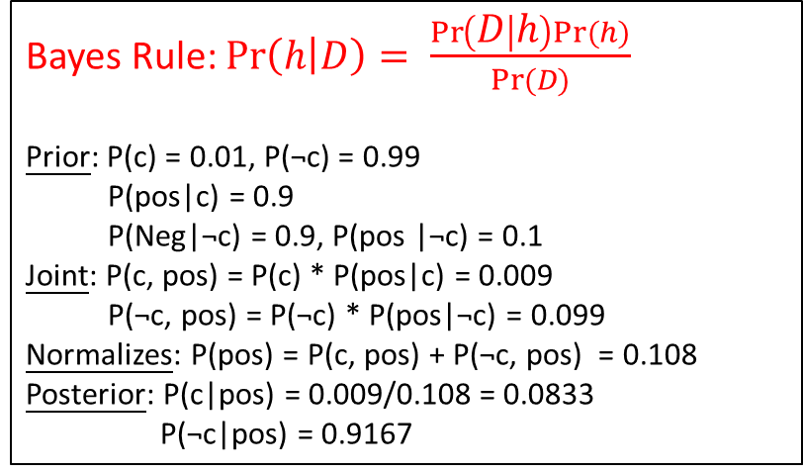

Naïve Bayes
Supervised
Classification/Regression
Purpose
Learn the Best (most probable) label / hypothesis given data and domain knowledge.
Introduction
Categorical features and models each as conforming to a Multinomial Distribution
Continuous valued features and models each as conforming to a Gaussian (normal) Distribution
Classical Naïve Bayes
Gaussian Naïve Bayes
Weighted vote h ∈ H, $Pr⁡(h|D)$
For each h ∈ H, calculate Pr(h|D). Output: $h_{MAP}= {Argmax \atop h}Pr⁡(h|D)$
Example
h(x) | Pr(h|D)
h1 + | 0.4
h2 - | 0.3
h3 - | 0.3
Bayes Rule: $\operatorname{Pr}\left(h | D\right)= \frac{\operatorname{Pr}\left(D | h\right)Pr⁡(h)}{Pr⁡(D)}$
Prior: P(c) = 0.01, P(¬c) = 0.99
P(pos|c) = 0.9
P(Neg|¬c) = 0.9, P(pos |¬c) = 0.1
Joint: P(c, pos) = P(c) * P(pos|c) = 0.009
P(¬c, pos) = P(¬c) * P(pos|¬c) = 0.099
Normalizes: P(pos) = P(c, pos) + P(¬c, pos) = 0.108
Posterior: P(c|pos) = 0.009/0.108 = 0.0833
P(¬c|pos) = 0.9167
Best hypothesis: “+”
Best label: “-”
Sum=1

Slide 36
Naïve Bayes - Gaussian Naïve Bayes
Python

Slide 37
Decision Tree
Supervised
Classification/Regression
Purpose
Introduction

Slide 38
Decision Tree
Python
Classification: DecisionTreeClassifier
Regression: DecisionTreeRegressor
from sklearn.tree import DecisionTreeClassifier #for classification
from sklearn.tree import DesisionTreeRegressor #for regression
from sklearn.tree import export_graphviz #plot decision tree graph

Slide 39
Stochastic Gradient Descent Classifier, SGDC
Purpose
Introduction

Slide 40
Stochastic Gradient Descent Classifier, SGDC
Python

Slide 41
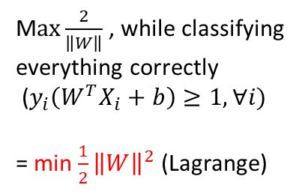





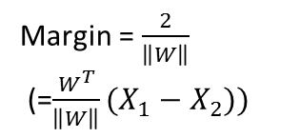
Support Vector Machine, SVM
Supervised
Classification/Regression
線性分類
Purpose
Find The best (maximizes distance to nearest point (maximize margin)) separating line (hyperplane).
Introduction
o
o
The best hyperplane
o
o
o
Margin
o
o
o
o
o
o
x
x
x
$$\frac{1}{\left\|W\right\|}$$
x
Outlier:
Do the best it can.
o
x
$$W^{T}X+b=1$$
x
x
$$\frac{1}{\left\|W\right\|}$$
相減
Margin = $\frac{2}{\left\|W\right\|}$
(=$\frac{W^{T}}{\left\|W\right\|}(X_{1}−X_{2}))$
M$ax\frac{2}{\left\|W\right\|}$ , while classifying everything correctly
($y_{i}\left(W^{T}X_{i}+b\right)≥1, ∀i)$
= min $\frac{1}{2}{\left\|W\right\|}^{2}$ (Lagrange)
x
x
$W^{T}X+b=$0
$$W^{T}X+b=−1$$
Support Vector:
提供最多分類資訊
若要解決非線性問題

Slide 42


SVM + Kernel Trick
Purpose
將原始資料透過非線性的映射函數Φ轉換到另外一個較高維度的特徵空間(Feature Space)中，然後在特徵空間上執行線性分類，以獲得更好的正確率。
Introduction
y
z = $x^{2}+y^{2}$
o
o
o
o
o
o
o
o
o
o
o
o
o
o
o
o
o
x
x
x
o
$$k\left(x_{i} , x_{j}\right)≔(Φ\left(x_{i}\right)∙Φ\left(x_{j}\right))$$
x
x
x
x
x
x
x
o
x
o
x
x
x
x
x
x
x
x
x
Linear Kernel
Polynomial Kernel
Radial Basis Function Kernel
Sigmoid Kernel
o
o
o
o

Slide 43
SVM (+ Kernel Trick)
Python
from sklearn.svm import SVC #for classification
from sklearn.svm import SVR #for regression
Parameters
kernel: ‘linear’, ‘rbf’ (default), ‘poly’, ‘sigmoid’, ‘precomputed’.
gamma:
C: controls tradeoff between smooth decision boundary and classifying training points correctly.
(larger C, more training points correct. Default=1.0)
Probability: when True, can use predict_proba, …, etc.
All may cause to overfit.

Slide 44
Support Vector Machines (SVM)
The best “off-the-shelf” supervised learning algorithm
SMO
Functional Margin
Gives an efficient way of solving the dual problem arising from the derivation of the SVM
||w||=1
Optimal Margin Classifier
Geometric Margin
Solve
Commercial Quadratic Programming (QP) code
Coordinate Ascent Algorithm
Derive an efficient algorithm that better Than
Optimization algorithm like gradient ascent, Newton’s method.
Optimization Problem’s dual form
Primal Optimal Problem
Take only O(n) time
?
Lagrange Duality
Use Kernels
SVM
+
KKT condition
K is symmetric positive semidefinite
To get optimal margin classifiers to work efficiently in very high dimensional spaces
Dual Optimal Problem
To make the algorithm work for non-linearly separable datasets as wall as be less sensitive to outliers.
Regularization
Theorem (Mercer)

Slide 45
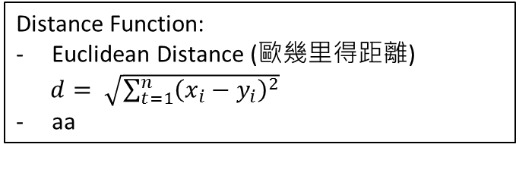
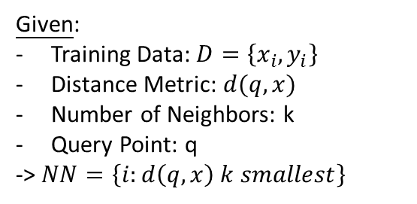
K-Nearest Neighbors, KNN
Supervised
Classification/Regression
Purpose
從樣本中找尋和新資料最近的k個鄰居，這些鄰居是什麼分類，新資料即為該分類。
Introduction
K=3
Instance-Based Learning (Memory-Based Learning)
A family of learning algorithms
將一群資料儲存起來，當有新資料時，與舊資料比對、分類
Instead of performing explicit generalization, compares new problem instances with instances seen in training, which have been stored in memory.
Remember, fast, simple, no generalization, may overfit.
y
o
o
o
o
●
o
o
o
x
x
o
o
o
o
x
o
x
x
x
x
x
x
Distance Function:
Euclidean Distance (歐幾里得距離)
$d= \sqrt{\sum_{t=1}^{n}{{\left(x_{i}−y_{i}\right)}^{2}}}$
aa
x
Given:
Training Data: $D=\left\{x_{i},y_{i}\right\}$
Distance Metric: $d(q,x)$
Number of Neighbors: k
Query Point: q
-> $NN=\left\{i:d\left(q,x\right) k smallest\right\}$
Return:
Classification: Vote
Regression: Mean
Cost Function
Advantages:
能夠在類別並非線性分開的情況下來分類
穩定: 訓練資料當中出現的小小干擾並不會嚴重影響獲得的結果
Disadvantages:
不提供一個真實的數學模型，對於每一個新分類都是必須以加入新資料到所有初始的實例，然後重複選擇K值進行計算程序才會產生。
要求相當高的資料量來產生真實的預測
對於被分析的資料當中的雜訊是敏感的

Slide 46
K-Nearest Neighbors, KNN
Python

Slide 47
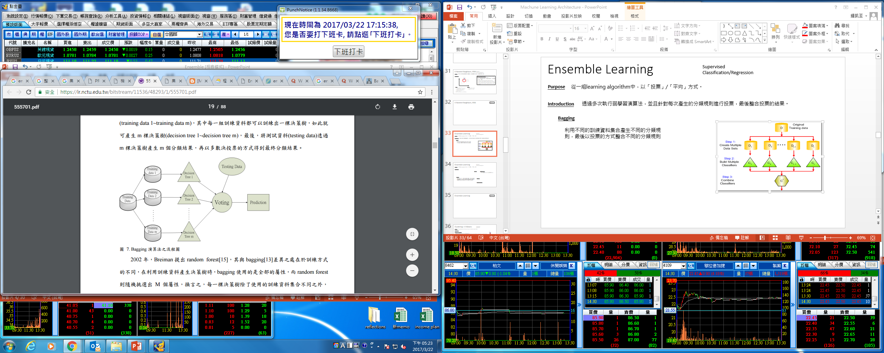
Ensemble Learning - Bagging
Supervised
Classification/Regression
Purpose
從一組learning algorithm中，以「投票」/「平均」方式得到最終分類結果。
Introduction
透過多次執行弱學習演算法，並且針對每次產生的分類規則進行投票，最後整合投票的結果。
Bagging (Bootstrap aggregating)
利用不同的訓練資料集合產生不同的分類規則，最後以投票的方式整合不同的分類規則。
Learn over a subset (uniformly randomly pick data) (sampling with replacement) of data, apply a learner.
將測試資料透過m棵決策樹產生m個分類結果，再以多數決投票的方式得到最終分類結果。
Decision Tree 只是舉例，不一定要是Decision Tree
相同學習演算法 +不同的訓練資料集合 -> 多個分類規則

Slide 48
Ensemble Learning – Random Forest
Supervised
Classification/Regression
與Bagging 的不同
學習演算法一定是決策樹
Bagging 使用全部的屬性，Random Forest則隨機挑選出M個屬性(強調訓練資料的差異外，再加上屬性選擇上的差異，以期得到差異性更大的決策樹集合，讓學習演算法可以涵蓋更多的資訊)

Slide 49
Ensemble Learning - Boosting
Supervised
Classification/Regression
Introduction
在每次的迭代中，更新所有資料的權重，提高分類錯誤的資料權重，反之降低分類正確的資料權重，最後則以有權重的投票方式整合每次迭代中產生的分類規則。
AdaBoost (最常被使用)
Gradient Boosting

Slide 50
Ensemble Learning - Stacking
Supervised
Classification/Regression
Stacking

Slide 51
Ensemble Learning
Python

Slide 52
Logistic Regression
Purpose
希望函數告訴我們屬於我們類別的特定元素的機率
Introduction
單層
Activate function: logistic function, sigmoid function (refers to the special case of the logistic function). Both have a characteristic sigmoid curve.

Slide 53


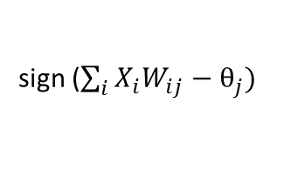


Perceptron Learning
Supervised
Classification
A particular kind of neural network.
AND, OR, NOT, XOR
XOR: output=0 if the inputs are the same. Not linearly separable.
單層感知器不能解決XOR等線性不可分的問題
Purpose
Find weights that map inputs to outputs. (train weights and biases)
Introduction
Input透過權重加權，若大於threshold，則傳回1，否則傳回0。
Input Layer
Hidden Layer
Output Layer
一開始隨機給予
$$W_{11}$$
$$θ_{1}|sign()$$
M-P Model
Y=1
X1
sign ($\sum_{i}{X_{i}W_{ij}}−θ_{j})$
$$W_{1m}$$
…
正數傳回1，負數傳回0
…
Xn
$$θ_{m}|sign()$$
Y=0
Higher weights, more important input.
演算法
正向傳導
反向傳導

Slide 54
Logistic Regression
Python
from sklearn.linear_model import LogisticRegression
Parameters
C: Inverse of regularization strength; must be a positive float. Like in support vector machines, smaller values specify stronger regularization.
Solver:

Slide 55





Neural Network
Supervised
Classification/Regression
倒傳遞神經網路 (Back-Propagation Neural Network)
將一組I/O問題變為一個非線性最佳化的問題
Gradient Descent 調整權值
Purpose
Find weights that map inputs to outputs. (train weights and biases)
透過迭代程序進行權重的最佳化
學習週期: epoch
Introduction
每一層透過權重加權，若大於threshold，則透過Activation Function轉換，並以另一層權重加權，以此類推。
增加類神經的複雜性，以能夠模擬複雜的非線性關係。但過多層會造成over-fitting
Input Layer
Hidden Layer
…
Hidden Layer
Output Layer
一開始隨機給予
$$W_{11}$$
$$θ_{1}|f$$
f: Activation Function
f ($\sum_{i}{X_{i}W_{ij}}−θ_{j})$
X1
The biggest difference between neural networks.
Y1
$$W_{1m}$$
…
…
Linear Model
Sigmoid Function
(消除不可微分點)
Ramp Function
Hyperbolic tan, tanh
…
Xn
Yp
$$θ_{m}|f$$
Higher weights, more important input.
單層+sigmoid->logistic
演算法
正向傳導
反向傳導：預測結果與實際結果的誤差依權重分配至隱藏層 (MSE -> Gradient Descent (Learning rate) -> 計算權重修正量
Activation functions have to be continuous and differentiable.

Slide 56
Neural Network
Concept
xw+b
yes
activation
Test: 1
no
AND
NO
Grade: 8
OR
NOT
XOR
…
no
yes

Slide 57
Neural Network
Python

Slide 58
Perceptron Learning
Python

Slide 59
Deep Learning

Slide 60
Deep Learning – Concepts
針對分類目的的進行選擇和放大，而其不變性則是代表它傾向於忽略那些不相關和無關緊要的部分。因此，透過多層非線性變換，在大約5-20層之間的深度時，深度學習系統可以學習和實做非常錯綜複雜的複雜函數，同時對極小的有關細節非常敏感，並且對於「輸入資料在物件識別不相關的部分所發生的大變化」非常不敏感，並對之冷漠以待。
Eg1. pixel -> edge -> texture -> motif -> part -> object
Eg2. character -> word -> word group -> clause -> sentence -> story
Deeper > wider

Slide 61
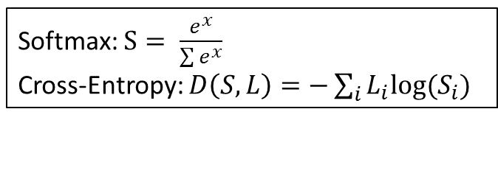
Deep Learning – Basic, Deep Neural Network, DNN
Using a neural network with several layers of nodes between input and output.
Purpose
Set network parameters $θ= \left\{W^{1}, b^{1}, W^{2}, b^{2},…, W^{L}, b^{L}\right\}$ such that input 1 -> $y_{1}$ has the maximum value, input 2 -> $y_{2}$ has the maximum value.
Introduction
Attempts to model high-level abstractions about data using networks of graphs. (very similar to AI)
Step1: Define network structure (先選出一群可能的函數)
Step2: Define learning target
Step3: Numerical method
Deep Neural Network, DNN
Rectified Linear Unit (ReLU) as the activation function.
Softmax layer as the output layer -> probability
Cost: Cross-entropy or Euclidean distance of the network output and target.
Loss: average cross-entropy
Minimize lost: Gradient descent / Stochastic gradient descent.
Softmax: $S= \frac{e^{x}}{\sum{e^{x}}}$
Cross-Entropy: $D\left(S,L\right)=−\sum_{i}{L_{i}log⁡(S_{i})}$
Activation function:
Tanh
Sigmoid (學習效果差)
Rectified linear unit (ReLU)

Slide 62
Deep Learning – Convolutional Neural Network, CNN
Using a neural network with several layers of nodes between input and output.
Purpose
設計目標是要來處理多陣列表達形式的資料。例如彩色圖像的資料會被表示為三個二維陣列，用以表示像素的顏色強度。
CNN和普通神經網路之間的實質區別在於，前者是對於圖像直接操作，而後者則是從中提取特徵，然後才對其操作。因此CNN是將輸入圖像的像素變成二維的特徵來輸入。
Introduction
經常用於從點陣圖形直接辨識出影像模式。
反向傳遞演算法(backpropagation)
每一捲積層的輸出都需要以非線性修剪(non-linear clipping)運算作為activation function
Convolution layer, subsampling layer, full connected layer
CNN是幾乎所有辨識問題的主要解決方案。
Break up the image into smaller pieces, recognize the smaller pieces, and then combine those pieces to get an idea of the overall image.
Keep doing.
By selecting a width and height that define a filter -> “Patch”
Simply slide horizontally or vertically -> The amount by which the filter slides is “Stride”(a hyperparameter which you can tune). Increasing the stride reduces the size of your model by reducing the number of total patches each layer observes.
The amount of filters in a convolutional layer is called the “filter depth”.
For instance,
Dog -> eyes, nose, flur
Nose -> two black holes…
計算model大小等 on Udacity

Slide 63
Deep Learning – Convolutional Neural Network, CNN
Don’t care about where cats are => weight sharing, statistical invariance
Padding = ‘SAME’
Strides:
隔幾格照一次
<python> =[batch, height, weight, depth]
Padding:
1: 外面加一圈，兩側共多兩行
0: 外面沒加一圈，跟valid一樣(?)
SAME: output size 一樣
Output map same size with input map
New height = {[old height – filter height + 2*padding]/strides} + 1
Padding = ‘VALID’
Pooling:
Decrease the size of output
Hence, prevent overfitting
Recently fallen out of favor, because:
big data, more concern underfitting
dropout is better
loss of information

Slide 64
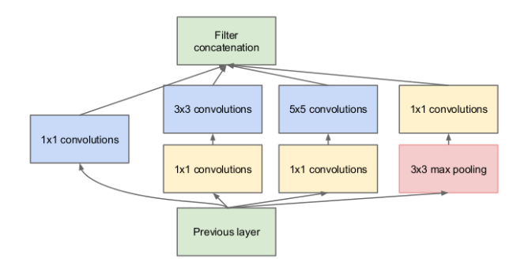
Deep Learning – Convolutional Neural Network, CNN
Inception Module:
Hard to decide 1*1 or 3*3 or 5*5 or … -> use all of them and let the model decide
1*1 convolution:
- For dimension reductionality

Slide 65
Deep Learning – Recurrent Neural Network, RNN
Using a neural network with several layers of nodes between input and output.
Purpose
Introduction
利用輸入當中的順序資訊(sequential information)來完成的。
在類神經網路中，通常假設每個輸入和輸出皆獨立於其他所有的輸入和輸出，然而，對於許多問題而言，這種假設並非正面。例如，在預測片語的下一個單詞時，知道她之前的單詞相當重要。這些神經網路稱為遞迴式的(recurrent)，因為它們對於輸入序列的所有元素執行相同的計算，且每個元素的輸出除了對於當前的輸入以外，對所有先前的計算也都是相依的。
用於從符號或音頻/語音波型辨識出時間序列上的模式。
反向傳遞演算法(backpropagation)

Slide 66
Deep Learning – Sequence Learning
Using a neural network with several layers of nodes between input and output.
Purpose
Introduction

Slide 67
Deep Learning
TensorFlow
Basic
基本名詞： graph : 表示一整個計算任務
op. : graph 中的節點，也就是對資料的操作
Session : 在 Session 中才會執行 graph
tensor : 表示數據資料，a multidimensional array of numbers
variable : 表示變數資料，負責維護狀態
feed 和 fetch : 賦值或者從其中獲取數據
ReLu: tf.nn.relu()
Applies the tf.nn.relu() function to the hidden_layer:
hidden_layer = tf.add(tf.matmul(features, hidden_weights), hidden_biases)
hidden_layer = tf.nn.relu(hidden_layer)
output = tf.add(tf.matmul(hidden_layer, output_weights), output_biases)
TensorFlow 簡易流程： 1. 製作 Graph：宣告 op. 表示資料操作（常數、運算子等等)
2. 宣告 Variable：用變數儲存狀態
3. 初始化 Variable
4. 開啟 Session 執行 Graph
這是一個用類神經網路做 regression 的程式。整體程式結構是： 1. 模擬一些要學習的資料點
2. 用 placeholder 傳入值 (後面用 feed_dict 餵資料)
3. 用 add_layer 畫 Graph
4. 設定要用 Gradient Descent 的 loss function
5. 初始化變數
6. 開啟 Session 執行 Graph

Slide 68
Unsupervised Learning

Slide 69
Learning Algorithm - Unsupervised Learning
Discrete (Classification)

Slide 70
Clustering – K-Means
Unsupervised
Classification
Purpose
Group data points that are close (or similar) to each other.
演算法決定了由哪些元素形成群集(cluster)，以及群集內什麼程度的相似性會使他們聚集在一起。
Introduction
o
o
K-means (hill climbing)
The most basic and most used algorithm.
Randomly draw cluster centers (clusters might be totally different depends on initial centers)
1. Assign (assign data points to the cluster center，計算每一筆資料到群中心的距離並分派)
2. Optimize (move centers to minimize the length)
3. Repeat 1. 2.
Limitation: Output for any fixed training set “NOT” always be the same.
之所以普及是因為它的收斂速度(convergence speed)以及易於實做(ease of implementation)等特性，但並不保證能找到全域的最佳解。可應用多次一些，然後於這些產生的解答中找出一個最能滿足需求的解答。另一個缺點是必須對要找出的群集數量(k值)做出選擇。
若資料未具備自然分隔性，將獲得奇怪的結果。此外，只有當資料所構成的群集可辨識為球形群集，演算法才會工作得很好。
o
o
o
o
o
o
o
o
o
o
o
o
o
o
o
o
o
o
o
o
o
o

Slide 71
Clustering - Hierarchicical
Unsupervised
Classification
Hierarchical (階層式分群法)
o
o
o
o
o
Agglomerative (凝聚分層法) (bottom-up)
把每個資料視為一個cluster
最近的兩個合成一個cluster
直到最後剩下預期cluster數
Divisive (分離分層法) (top-down)
o
o
依定義兩個cluster之間的距離方式：
Root
Single-Linkage Clustering (最近法)
Complete-Linkage Clustering (最遠法)
Average-Linkage Clustering (平均法)
g
a
b
c
d
e
f
Centroid Method (中心法)
Hierarchical Agglomerative Cluster Structure
Wald’s Method (華德法、華德最小變異法)
Soft
Gaussian Mixture Model

Slide 72
Clustering - Others
Unsupervised
Classification
Soft
Gaussian Mixture Model

Slide 73
Clustering
Python
Class sklearn.cluster
K-means
Soft
Hierarchical
Gaussian Mixture Model
.KMeans
Input Parameters
n_clusters (default: 8)
Max_iter (default: 300)
n_init

Slide 74
Reinforcement Learning

Slide 75
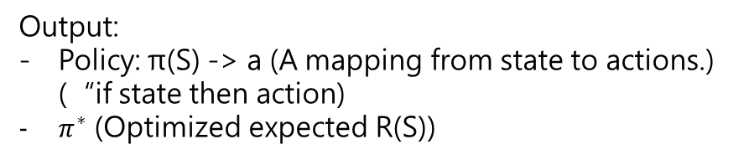
Reinforcement Learning
分為動態規劃(bootstrapping method)、蒙地卡羅法、時間差分法(bootstrapping method)三類。
One mechanism for doing decision making.
Purpose
Get the agent to act in the world so as to maximize its rewards.
Introduction
How can an agent learn behaviors when it does not have a teacher to tell it how to perform?
The agent has a task to perform
It takes some actions in the world
At some later point, it get feedback telling it how well it did on performing the task
The agent performs the same task over and over again
Reinforcement learning
supervised learning
unsupervised learning
y = f(x)
y = f(x)
f(x)
z
find
find
find
give
give
give
Output:
Policy: π(S) -> a (A mapping from state to actions.) (“if state then action)
$π^{∗}$ (Optimized expected R(S))
Given:
Environment: Markov Decision Process, MDP
State: S
Model: T(S, a, S’) ~ Pr(S’|S, a)
Actions: A(S)
Reward: R(S), R(S, a), R(S, a, S’)
<S, a, r>, <S, a, r>, π(), R(S)
x
y
z
f()
Domain knoledge

Slide 76
RL – Value Iteration, Policy Iteration, Q learning
Value Iteration
The essential idea behindvalue iteration is this: if we knew the true value of each state, our decision would be simple: always choose the action that maximizes expected utility. But we don’t itinially know a state’s true value; we only know its immediate reward. But, for example, a state might have low initial reward but be on the path to a high-reward state.
The true value (or utility) of a state is the immediate reward for that state, plus the expected discounted reward if the agent acted optimally from that point on:
U(s) = R(s) + γmaxaPs0 T(s, a, s0)U(s0)
Note that the value for each state can potentially depend on all of its neighbors’ values. If our state space is acyclic, we can use dynamic programming to solve this. Otherwise, we use value iteration.

Slide 77
Reinforcement Learning – Q Learning
agent: <Class> LearningAgent
__init__:
Environment
Learning
Alpha & epsilon
environment:
reset:
Set destination
Alpha & epsilon:
if testing: =0, if not: update epsilon using a decay function
createQ:
If the state is not in Q-table, build it. (initial Q-value = 0)
When epsilon < tolerance, start testing
simulator:
choose_action:
Not learning: random
Learning:
random with epsilon
highest Q-value (if more than 1 highest Q-value, choose it randomly.)
Q-table:
State 1 :
action 1: Q-value 1
action 2 : Q-value 2
…
State 2:
action 1: Q-value 1
action 2 : Q-value 2
…
get_maxQ:
update:
State currently
Action I choose
Reward I receive
build_state:
learn:
New Q-value = (1-alpha)*old Q-value + alpha*reward

Slide 78
Reinforcement Learning
Python

Slide 79
Regularization

Slide 80
Regularization (L2 Regularization)
Prevent overfitting
Add penalty to loss??

Slide 81
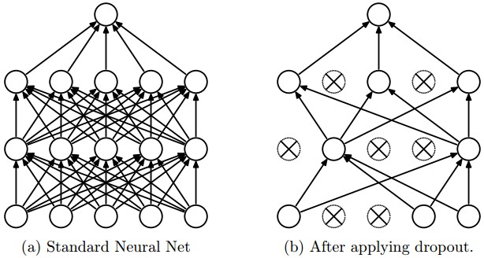
Dropout
regularization technique for reducing overfitting.
The technique temporarily drops units (artificial neurons) from the network, along with all of those units' incoming and outgoing connections.
Randomly dropout samples??

Slide 82
Evaluation

Slide 83
Evaluation
How validation let us compare different models against one another.
The problem at hand will determine how we choose to evaluate a model.
Classification metrics: Accuracy, Confusion metrix
Accuracy
Score() method for classifier in sklearn.
Shortcomings of accuracy:
1. not ideal for skewed classes.
2. may want to err on side of guessing innocent/guilty.
Recall = (被預測到正確的個數)/(總共真實個數)
= TP/(TP+FN)
Precision = (預測正確的個數)/(總共預測個數)
= TP/(TP+FP)
F1-score:
0 <= F1 = 2*(precision*recall)/(precision + recall) <=1
Confusion metrix
Actual class
Positive
Negative
Positive
TP
FP
TP: True Positive
TN: True Negative
FP: False Positive
FN: False Negative
Predicted class
Negative
FN
TN

Slide 84
Improve the results
Time-consuming, a matter of luck
Try to improve:
Getting more training examples
A smaller set of features
A larger set of features
Change the features
Run gradient descent for more iterations
Other optimization algorithms
Different value for λ
Other learning algorithms
Run diagnostic to figure out what the problem is:
(Fixes high variance)
Getting more training examples
A smaller set of features
(Fixes high bias)
A larger set of features
Change the features
(Fixes optimization algorithm)
Run gradient descent for more iterations
Other optimization algorithms
(Fixes optimization objective)
Different value for λ
Other learning algorithms
Locally Weighted Linear Regression Algorithm (LWR)
Makes the choice of features less critical.
Error arise
Generalization error
Underfitting (bias)/Overfitting (variance)

Slide 85
Improve the results
Error Analysis
Try to understand what your sources of error are.
Try to explain the difference between current performance and perfect performance.
Ablative Analysis
Try to explain the difference between some baseline (much poorer) performance and current performance.
Remove components from your system one at a time, to see how it breaks.
How much error is attributable to each of the components?
How much did each of these components really help?
Plug in ground-truth for each component, and see how accuracy changes

Slide 86
Learning Theory
Lemma 1. The union bound
ERM: Empirical Risk Minimization
Lemma 2. Hoeffding inequality
(Chernoff bound)
The most basic learning algorithm
Select whichever of these k hypotheses has the smallest training error.
The case of finite H
The case of infinite H
Uniform Convergence
Vapnik-Chervonenkis dimension VC(H)
We can bound either m, gamma, and the probability of error in terms of the other two.
Theorem
Corollary
Key property: the number of training examples needed to make this guarantee is only logarithmic in k.
Sample complexity
Theorem
Corollary

Slide 87
Foundamation
Deadline: 30y
Goal
Language
(English, German)
TOEFL, GRE, GMAT
Other exam
Famous School
Machine Learning
Big Data
Artificial Intelligence
Famous job
Goal
Contest
(Hackthon, Kaggle, …)
Programming
(Python, R, C-lang, Matlab, etc.)
Examples
Finance
(Financial Engineering, Trading)
Trading done

